Slide 1
Hands-on Machine Learning with Scikit-Learn, Keras & Tensorflow
Chapter 1. The Machine Learning Landscape
August. 14. 2022.
FML Team1

Slide 2
I. | Why Use ML?
II. | Supervised vs. Unsupervised
III. | Batch vs. Online
IV. | Model-based vs. Instance-based
V. | Main Challenges of ML
VI. | Testing & Validating

Slide 3
I. Why Use ML?
"A computer program is said to learn from experience E with respect to some task T and some performance measure P, if its performance on T, as measured by P, improves with experience E."
—Tom Mitchell, 1997

Slide 4
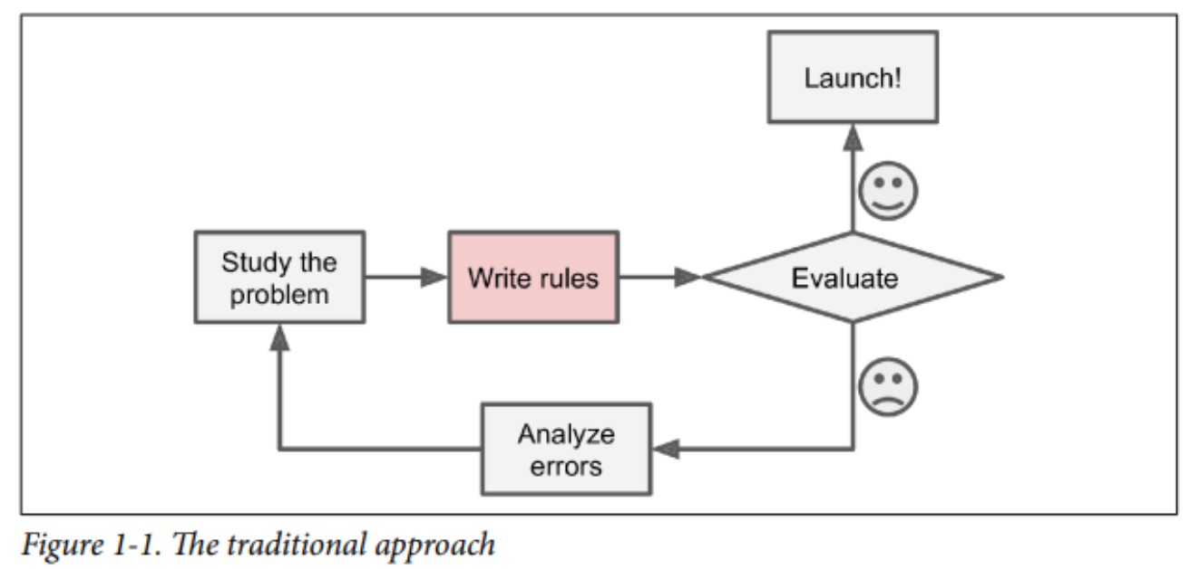
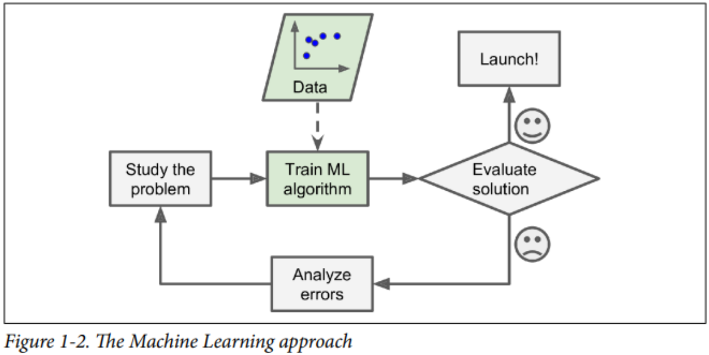
I. Why Use ML?

Slide 5
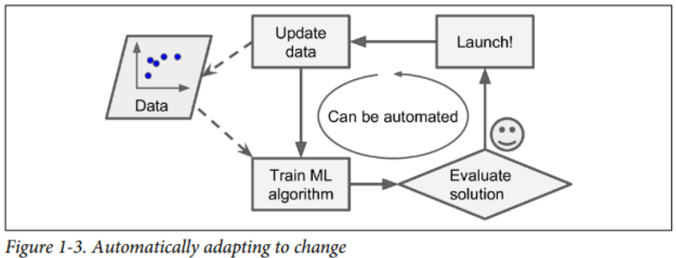
I. Why Use ML?
To summarize, ML is great for:
Problems for which existing solutions require a lot of fine-tuning or long lists of rules:
Complex problems for which using a traditional approach yields no good solution
Fluctuating environments
Getting insights about complex problems and large amounts of data.

Slide 6
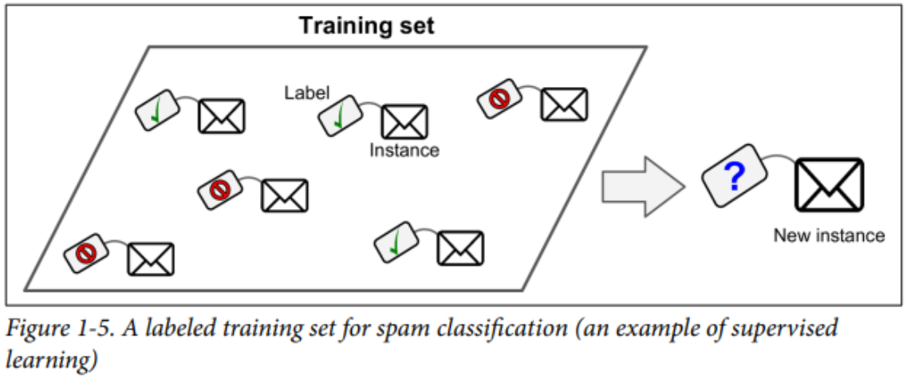
II. Supervised vs. Unsupervised
In Supervised Learning, the training set you feed includes the desired solutions, called labels
A typical supervised learning task is classification. e.g. spam filter

Slide 7
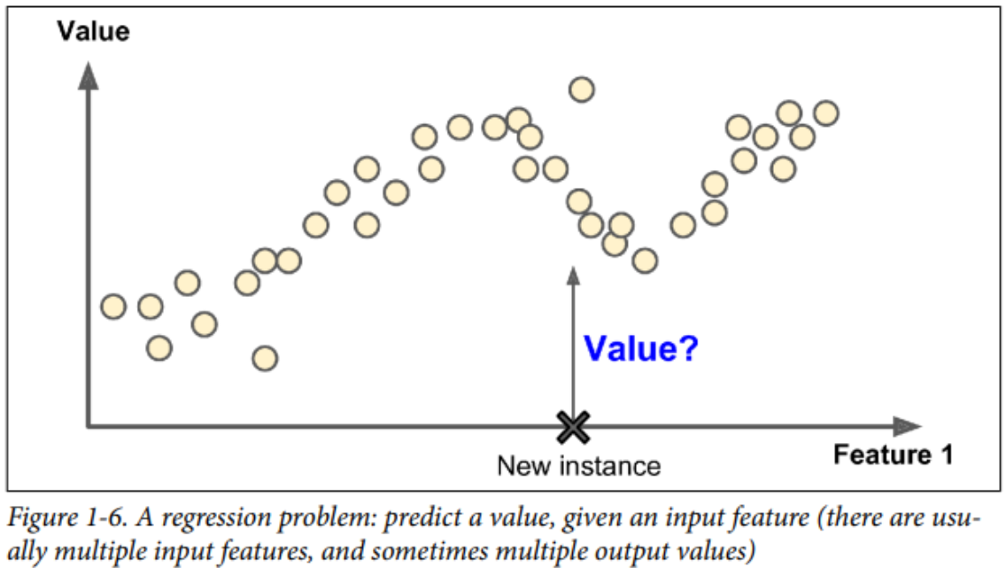
II. Supervised vs. Unsupervised
Another typical task is to predict a target numeric value, such as the price of a car, given a set of features called predictors.

Slide 8
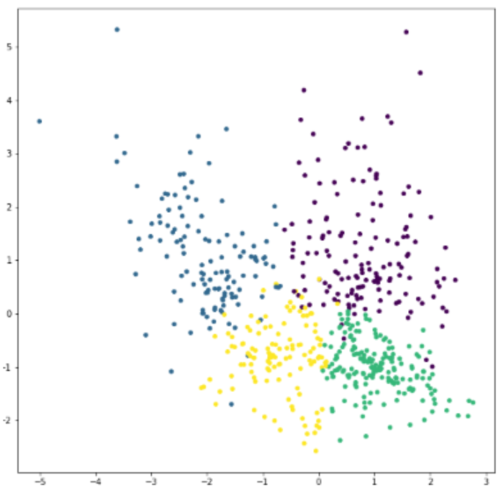
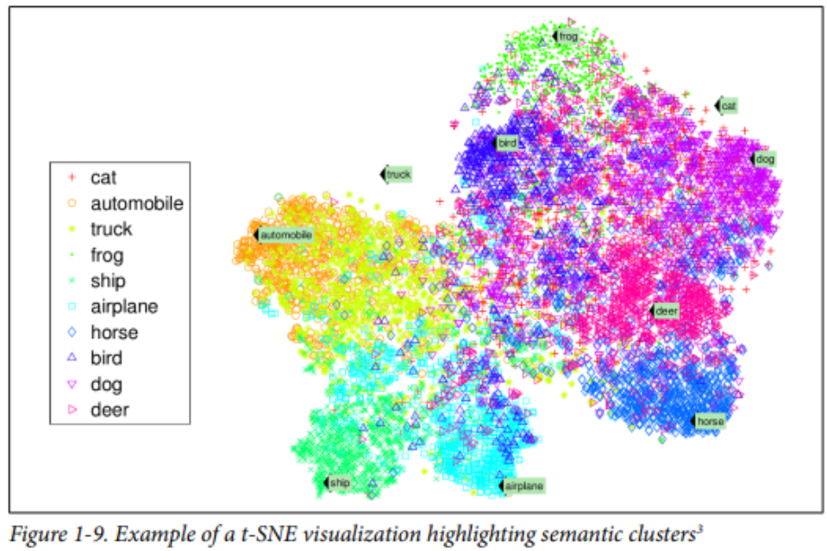
II. Supervised vs. Unsupervised

Slide 9
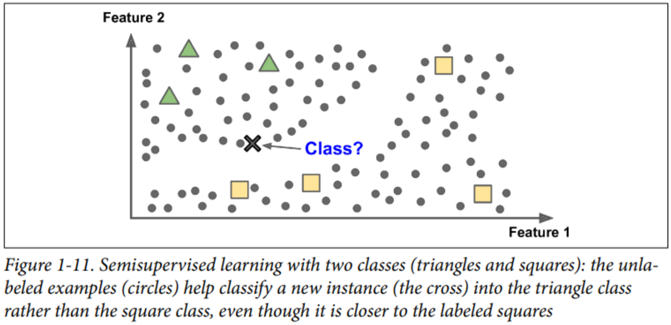
II. Supervised vs. Unsupervised
Since labeling data is usually time-consuming and costly, you will often have plenty of unlabeled instances, and few labeled instances.
Most semisupervised learning algorithms are combinations of unsupervised and supervised algorithms

Slide 10
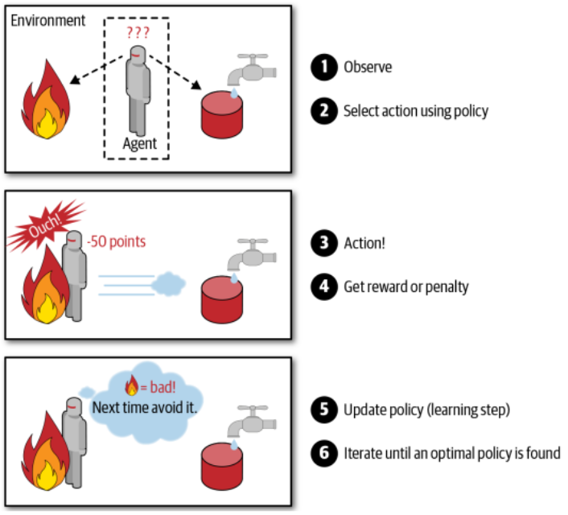
II. Supervised vs. Unsupervised
The learning system, called an agent in this context, can observe the environment, select and perform actions, and get rewards in return.

Slide 11
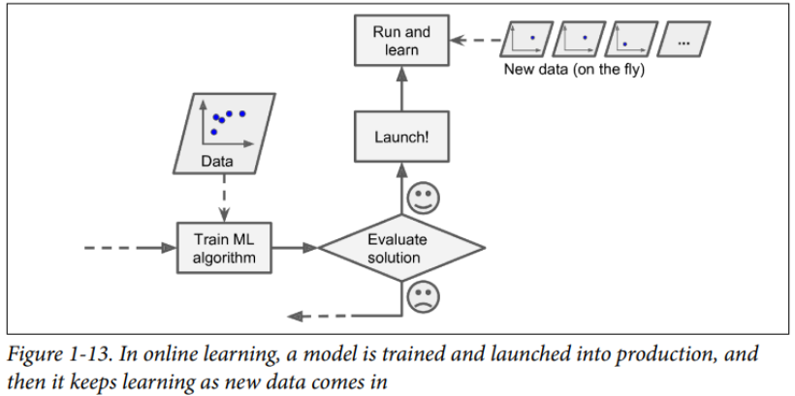
III. Batch vs. Online
Online learning is great for systems that receive data as a continuous flow (e.g., stock prices) and need to adapt to change rapidly or autonomously. It is also a good option if you have limited computing resources
One important parameter of online learning systems is how fast they should adapt to changing data: this is called the learning rate. If you set a high learning rate, then your system will rapidly adapt to new data, but it will also tend to quickly forget the old data

Slide 12
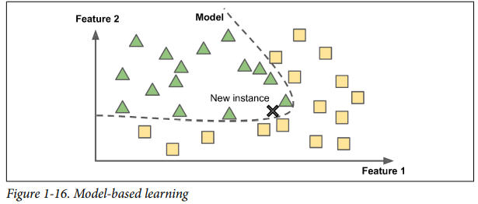
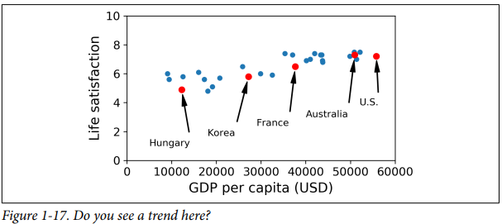
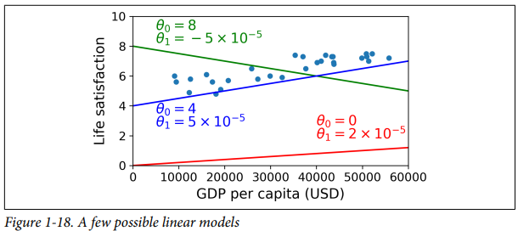

IV. Model-based Learning
To build a model of these examples and then use that model to make predictions (e.g., latent factor approach)

Slide 13
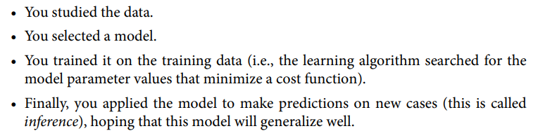
IV. Model-based Learning: Procedure
To build a model of these examples and then use that model to make predictions (e.g., latent factor approach)

Slide 14
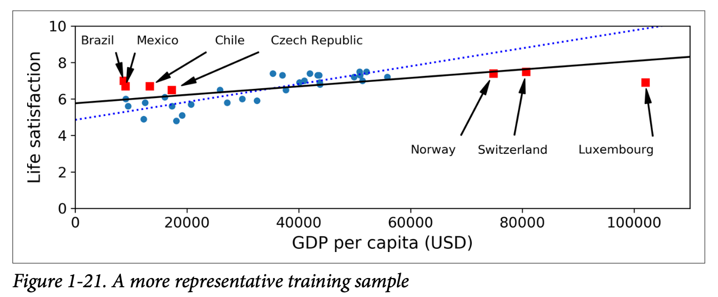
V. Main Challenges of ML
Insufficient Quantity of Data
How many apples must be labelled before algorithm can recognize apples of a wide range of colors and shapes?
Nonrepresentative Training Data
When selecting samples, need to be accurate while avoiding bias
Small samples susceptible to noise
Large samples magnify sampling bias (nonresponse bias, voluntary response bias)

Slide 15
V. Main Challenges of ML
Poor Quality Data (Errors, Outliers, Noise)
Fix manually
Discard
Missing Data
Ignore attribute altogether
Ignore instances with missing data
Imputation
Model trained with vs. without missing feature
Irrelevant Features
Feature engineering identifies a good set of features to train on via the following steps:
Feature selection (select most useful features among existing ones)
Feature extraction (combining existing features to produce more useful ones, e.g. dimensionality reduction)
Create new features by gathering new data

Slide 16
V. Main Challenges of ML
Overfitting of training data
When model is too complex relative to the amount and noisiness of the training data :
Model performs well on training data, but does not generalize well
Complex models detect subtle patterns in noise that do not generalize to new instances.
Solutions to overfitting include:
Simplifying model
select fewer parameters
reduce attributes
Constrain model (regularization)
Hyperparameter controls amount of regularization
Gather more training data
Reduce noise in data

Slide 17
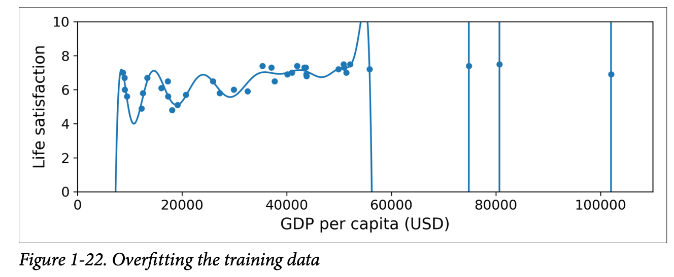
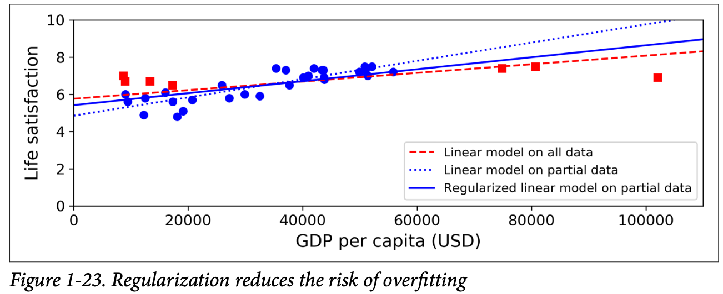
V. Main Challenges of ML

Slide 18
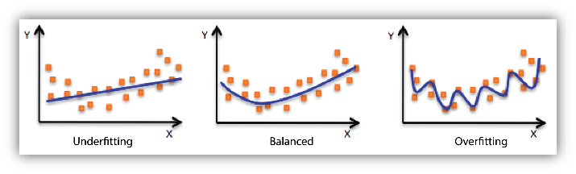
V. Main Challenges of ML
Underfitting of training data
When model is too simple to learn the underlying structure of data
Model performs well on training data, but does not generalize well
Complex models detect subtle patterns in noise that do not generalize to new instances.
Solutions to overfitting include:
Simplifying model
Select more parameters to construct more powerful model
Feature engineering to feed better features
Reduce constraints on model via reducing regularization
Hyperparameter controls amount of regularization
Gather more training data
Reduce noise in data

Slide 19
VI. Testing & Validating
Data split into two sets
Training set (80%)
Test set (20%)
Generalization error (out-of-sample error)
Estimate error rate of new cases by evaluating model on test set
Low training error + high generalization error = overfitting

Slide 20
VI. Testing & Validating
Choose model and regularization hyperparameters with lowest generalization error (avoids overfitting)
Problem: Using single test set does not generalize well
Measuring generalization error multiple times on a particular test set does not guarantee that model and hyperparameters perform well on new data
Solution: Hold out part of the training set as validation set
(Training – Validation) set: train multiple models with hyperparameters
Validation set: evaluate several candidate models and select best model
Full training set: train best model to get final model
Test set: Evaluate final model
Validation set size selection is important
Too small: imprecise model evaluation
Too large: (Training – Validation) <<< Training -> candidate models trained on a much smaller training set -> selecting the fastest sprinter to participate in a marathon.
Cross Validation
Cross-validation each model evaluated once per validation set after being trained on rest of data
Pro: Averaging evaluations of model yields accurate measure of performance
Con: Training time increases (multiplied by number of validation sets)

Slide 21
VI. Testing & Validating
No free lunch theorem
“if you make absolutely no assumption about the data, then there is no reason to prefer one model over any other.”
No a priori guarantee of panacea model (linear, neural network) that works on data set
The only way to know for sure which model is best is to evaluate them all.
Through reasonable assumptions about data, evaluate few models and compare performance

